Slide 1



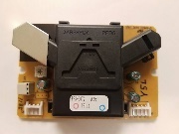
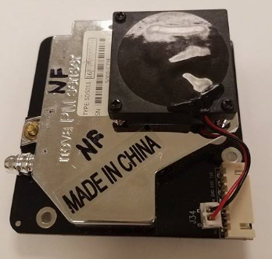
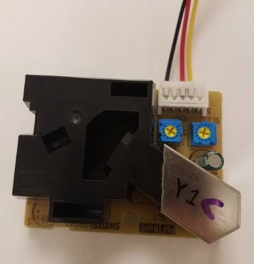
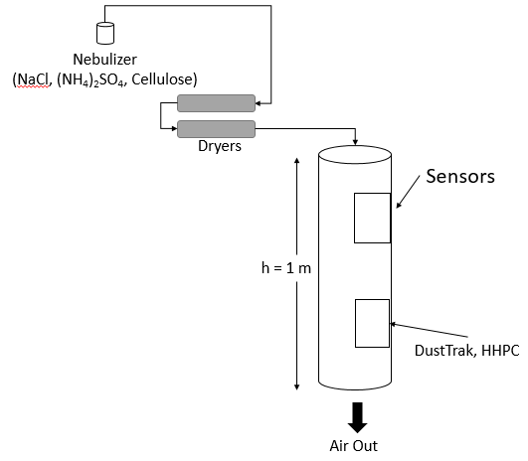
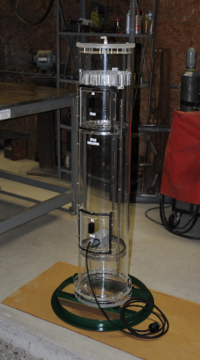
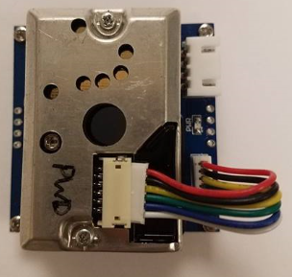
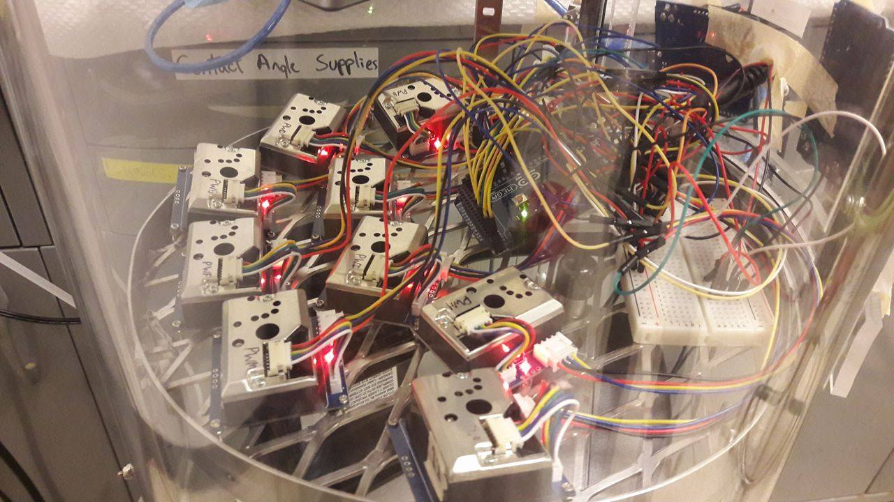
Calibration of Low Cost Dust Sensors
Orthodoxia Zervaki¹, Lina Zheng², Dionysios D. Dionysiou¹, Pramod Kulkarni², Gregory M. Zarus³
¹ Department of Biomedical, Chemical and Environmental Engineering, University of Cincinnati, Cincinnati, OH, USA² Centers for Disease Control and Prevention, National Institute for Occupational Safety and Health, Cincinnati, OH USA ³Agency for Toxic Substances and Disease Registry, Atlanta, GA, USA
MOTIVATION
RESULTS
RESULTS
High concentrations of aerosols affect human health, especially the respiratory and cardiovascular system [1,2].
The particle diameter is highly related to their impact [3]. All-cause daily mortality is associated with coarse particles (2.5-10 µm) [4]. Fine particles (≤2.5 µm; PM2.5) are the most hazardous group of particles generating atherosclerosis and pulmonary and systemic inflammation [5, 6].
Most monitoring sites use large and expensive instruments that demand intensive labor to achieve high-resolution and continuous, in real-time PM measurements.
Portable, miniature low-cost dust sensors detecting PM2.5 concentrations, have been recently developed and introduced for temporal and spatial airborne particle concentration monitoring.
With greater density of samplers providing multiple samples hourly, we will better be able to categorize PM exposures of sub populations and hopefully better understand the health impact of PM.
PPD60PV-T2 (Shinyei)
SDS011 (Nova Fitness Co.)
7a
7b
4a
4b
Figure 4. Analog Output Voltage (V) as a function of number concentration for a. PPD60PV A b. PD60PV C, where in polynomial equation y represents the Analog Output Voltage (V) provided by the sensor and x the number concentration (pcs per cubic feet) measured by HHPC.
PPD42NS (Shinyei)
7c
Figure 7 Measurement of PM2.5 and PM10 mass concentration of SDS011 (Nova Fitness Co.)
model in comparison to DustTrak for a. Sodium Chloride, b. Ammonium Sulfate and c. Cellulose.
OBJECTIVES
DISCUSSION
The objective of this project is to study the response of a variety of low-cost dust sensors from various manufacturers, which use scattered light. The effect of humidity, physical and chemical properties of the particles to the efficiency of the sensors are taking into account.
For PPD60PV sensors the particle composition does not affect their response. Moreover, similar behavior is noticeable between different sensors of the same model.
For PPD42NS sensors the aerosol source can significantly affect their response, in contrast to model PPD60PV. Additionally, sensors of the same model provide different results.
Measurements of the model GP2Y1010AU0F after its calibration are in a good agreement with mass concentration measured by DUSTTRAK™ 8520.
SDS011 sensor’s results showed high linearity with the measurements of DUSTTRAK™ 8520, especially for sodium chloride and ammonium sulfate.
5a
5b
Figure 5. Lo Pulse Occupancy Time (%) as a function of number concentration for a. PPD42NS A b. PPD42NS C, where in linear equation y represents the lo pulse occupancy time (%) provided by the sensor and x the number concentration (pcs per cubic feet) measured by HHPC.
Figure 1. Schematic diagram
of the experimental set up.
Figure 2. Aerosol
Test Chamber
GP2Y1010AU0F (Sharp)
CONCLUSIONS
The findings in the present study demonstrated that sensors had high linearity and repeatability for each aerosol source.
Sensors of the same manufacturer/model had varying responses indicated the need of their prior calibration independently.
The different aerosol composition had a significant impact on the sensors’ response.
Collectively, our results indicated that low-cost sensors can be promising for the measurement of temporal and spatial aggregate concentrations and replace expensive and large instruments.
Figure 3. Model
GP2Y1010AU0F (Sharp)
6a
6b
METHODS AND MATERIALS
Three PPD42NS (Shinyei), twelve PPD60PV-T2 (Shinyei), nine SDS011 (Nova Fitness Co.) and twelve GP2Y1010AU0F (Sharp) sensors were evaluated or calibrated. The sensors measuring mass concentration were calibrated using DUSTTRAK™ Aerosol Monitor Model 8520, and sensors measuring number concentration were calibrated by the Hand Held Particle Counter (HHPC-6). For this study, an aerosol test chamber was used for the calibration of dust sensors in three different aerosol sources (ammonium sulfate, sodium chloride and cellulose).
ACKNOWLEDGEMENTS
Thanks to the Center For Disease Control’s Innovation Fund to promote the development of new innovations which show promise in making a substantial impact on public health.
6c
Figure 6 Measurement of mass concentration of calibrated GP2Y1010AU0F (Sharp) model in comparison to DustTrak for a. Sodium Chloride, b. Ammonium Sulfate and c. Cellulose.
Contact
References
Orthodoxia Zervaki
Department of Biomedical, Chemical and Environmental Engineering, University of Cincinnati, Cincinnati, OH, USA
Email: s.zervaki@gmail.com
Phone:513-399-2134
Davidson, C. I., Phalen, R. F., & Solomon, P. A. (2005). Airborne Particulate Matter and Human Health: A Review. Aerosol Science and Technology, 39(8), 737–749. https://doi.org/10.1080/02786820500191348
Dockery, D. W., & Pope Iii, C. A. (1994). ACUTE RESPIRATORY EFFECTS OF PARTICULATE AIR POLLUTION. Annu. Rev. Public Health, 15, 107–32. Retrieved from http://www.annualreviews.org/doi/pdf/10.1146/annurev.pu.15.050194.000543
Wilson, R., & Spengler, J. D. (1996). Particles in our air : concentrations and health effects. [Cambridge Mass.]: Harvard School of Public Health. Retrieved from http://www.worldcat.org/title/particles-in-our-air-concentrations-and-health-effects/oclc/36100524
Samoli, E., Peng, R., Ramsay, T., Pipikou, M., Touloumi, G., Dominici, F., … Katsouyanni, K. (2008). Acute Effects of Ambient Particulate Matter on Mortality in Europe and North America: Results from the APHENA Study. Environmental Health Perspectives, 116(11), 1480–1486. https://doi.org/10.1289/ehp.11345
Who (2013). Health effects of particulate matter. Policy implications for countries in eastern Europe, Caucasus and central Asia.
Pope, C. A., Burnett, R. T., Thurston, G. D., Thun, M. J., Calle, E. E., Krewski, D., & Godleski, J. J. (2004). Cardiovascular Mortality and Long-Term Exposure to Particulate Air Pollution. Circulation, 109(1). Retrieved from http://circ.ahajournals.org/content/109/1/71
Poster Number: 32

